Slide 1

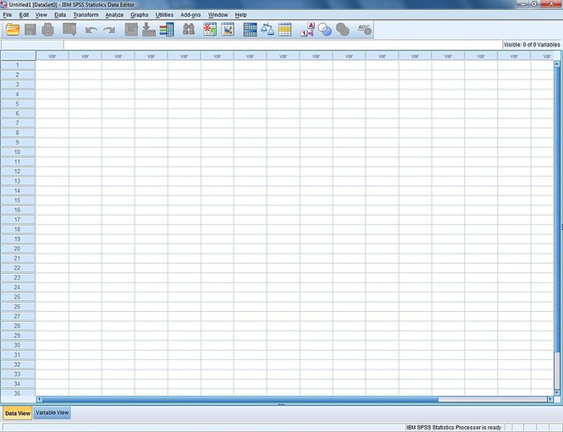

Slide 2

An Introduction to SPSS II
Software Application

Slide 3
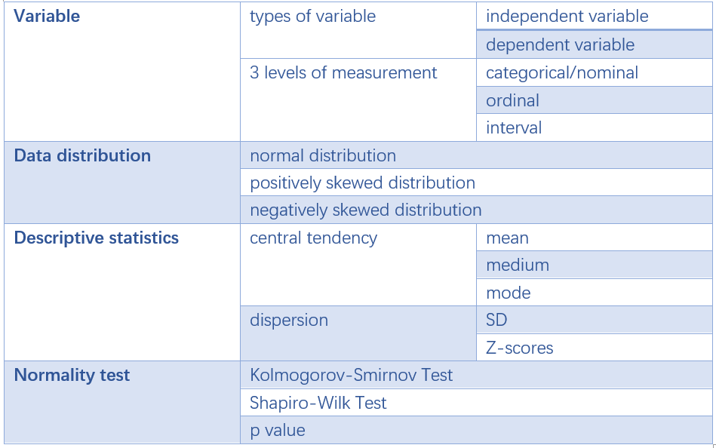
Review

Slide 4
01.
The Correlation Test
02.
The Cronbach α Test
03.
The T-Test
04.
The Chi-Square Test

Slide 5
01
PART ONE
The Correlation Test

Slide 6
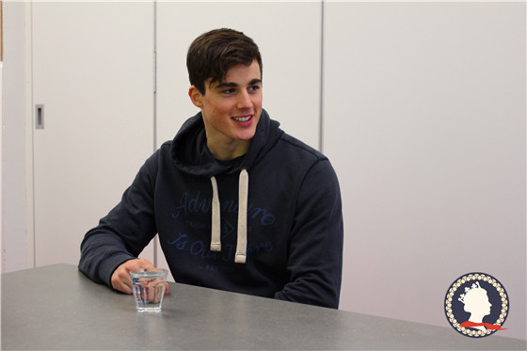


Slide 7
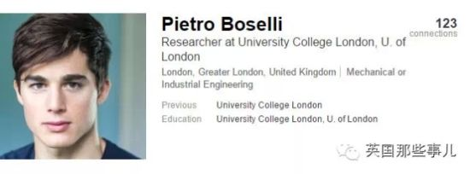


Slide 8
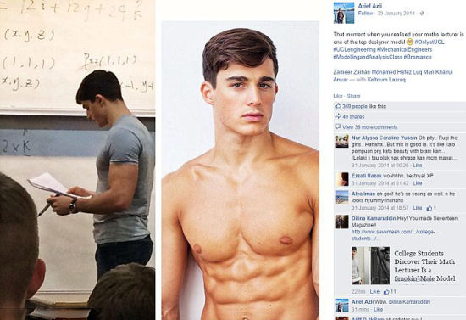



Slide 9

Victoria Magrath
PhD, the University of Manchester
Fashion retailing

Slide 10


Would you like to be taught by teachers like them?

Slide 11

Correlation
PART 1

Slide 12

Correlation
PART 1
“I’ll be the first to be in class!”
“I’ll never miss a single class!”
“I’ll be active and ask as many questions as possible in class!”
“I’ll devote all my energy and time to studying!”

Slide 13
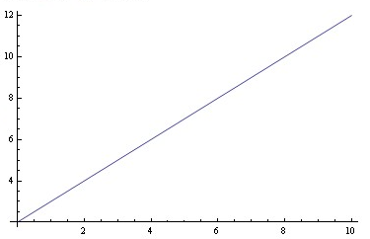

Correlation
PART 1
A hypothesis
Students hard work
Teachers’ appearance

Slide 14

Correlation
PART 1
Research question
Is there a relationship between teachers’ appearance and students’ hard work?
How do we assess teachers' appearance?
How do we assess students’ hard work?

Slide 15
Correlation
PART 1
Correlation is about
1) the relationship between 2 variables and more variables;
2) and the strength of the relationship.
Pearson’s Coefficient (Pearson’s r)
1) is the most common measure of correlation;
2) and is used for interval variables (or sometimes ordinal variables).

Slide 16
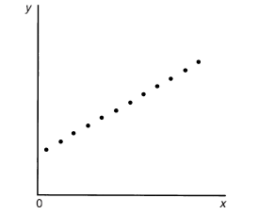
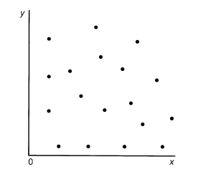
Correlation
PART 1
Scatterplots
A perfect relationship
No relationship or virtually no relationship

Slide 17
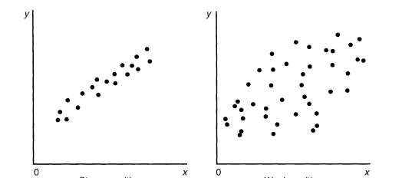
A strong positive relationship
A weak positive relationship

Slide 18
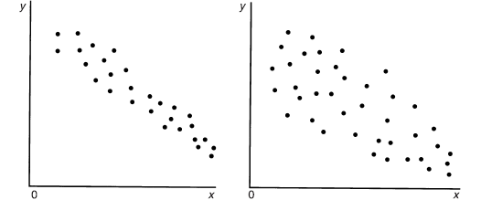
A strong negative relationship
A weak negative relationship

Slide 19
Correlation
PART 1
The correlation coefficient (r)
The correlation coefficient has to lie between −1 and +1.
+1 indicates a perfect positive relationship, −1 indicates a perfect negative relationship, and 0 indicates no linear relationship at all.
±.3 represents a low correlation, ±.3-±.7 is a medium correlation and ±.7 is a high correlation.

Slide 20
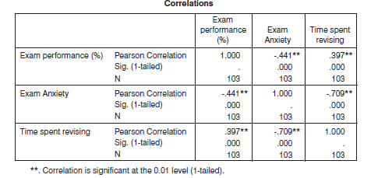
Correlation
PART 1

Slide 21
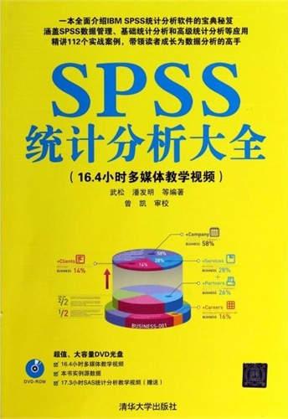
Now
Get it started

Slide 22
02
PART TWO
The Cronbach α Test

Slide 23
The Cronbach α Test
PART 2
The Cronbach α Test is used to test the internal reliability (the consistency of multiple items for the same construct).
It is a special kind of correlation test.
The nearer the correlation coefficient is to 1 preferably at or over 0.8, the more internally reliable is the scale. The rule of thumb is that the coefficient should be 0.8 or above.

Slide 24
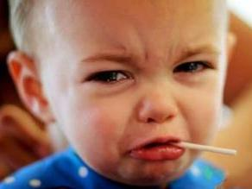
Oh, no!!! Why do I have to learn to use SPSS?

Slide 25

The Cronbach α Test
PART 2
Anxiety of Using Computers
1. I have little experience of computers.
2. All computers hate me.
3. Computers are useful only for playing games.
4. I worry that I will cause irreparable damage because of my incompetence with my computers.
5. Computers have minds of their own and deliberately go wrong whenever I use them.
6. Computers are out to get me.
7. SPSS always crashes when I try to use it.

Slide 26
Inter-Item Correlation Matrix
 | I have little experience of computers | All computers hate me | Computers are useful only for playing games | I worry that I will cause irreparable damage because of my incompetence with computers | Computers have minds of their own and deliberately go wrong whenever I use them | Computers are out to get me | SPSS always crashes when I try to use it
I have little experience of computers | 1.000 | .514 | .322 | .466 | .402 | .360 | .513
All computers hate me | .514 | 1.000 | .084 | .442 | .441 | .391 | .501
Computers are useful only for playing games | .322 | .284 | 1.000 | .302 | .255 | .295 | .293
I worry that I will cause irreparable damage because of my incompetence with computers | .466 | .442 | .302 | 1.000 | .450 | .342 | .533
Computers have minds of their own and deliberately go wrong whenever I use them | .402 | .441 | .255 | .450 | 1.000 | .380 | .498
Computers are out to get me | .360 | .391 | .295 | .342 | .380 | 1.000 | .343
SPSS always crashes when I try to use it | .513 | .501 | .293 | .533 | .498 | .343 | 1.000

Slide 27
Item-Total Statistics
 | Scale Mean if Item Deleted | Scale Variance if Item Deleted | Correlated Item-Total Correlation | Squared Multiple Correlation | Cronbach's Alpha if Item Deleted
I have little experience of computers | 15.87 | 17.614 | .619 | .398 | .791
All computers hate me | 15.17 | 17.737 | .619 | .395 | .790
Computers are useful only for playing games | 15.81 | 20.736 | .400 | .167 | .824
I worry that I will cause irreparable damage because of my incompetence with computers | 15.64 | 18.809 | .607 | .384 | .794
Computers have minds of their own and deliberately go wrong whenever I use them | 15.22 | 18.719 | .577 | .350 | .798
Computers are out to get me | 15.33 | 19.322 | .491 | .250 | .812
SPSS always crashes when I try to use it | 16.62 | 17.832 | .647 | .447 | .786
Reliability Statistics
Cronbach's Alpha | Cronbach's Alpha Based on Standardized Items | N of Items
.823 | .821 | 7

Slide 28
Now
Get it started

Slide 29
03
PART THREE
The T-Test

Slide 30
The T-Test
PART 3
A Tentative Theory
Alcohol drinking
Improved fluency in English

Slide 31
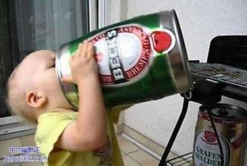
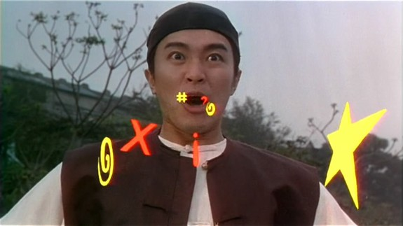

Slide 32
The T-Test
PART 3
Research Design
Experimental group
drinking 1 bottle of beer
English test of fluency
Control
group
No beer
English test of fluency
Research question: Does the experimental group perform better than the control group in the English test of fluency?
In other words, is there a significant difference in the mean score of the fluency test between the experimental group and the control group?

Slide 33
The T-Tests
PART 3
paired- samples t-test
used when there are two experiment conditions and different participants were assigned to each condition
Independent-samples t-test
T-tests
used when there are two experiment conditions and the same participants took part in both conditions

Slide 34
The T-Test
PART 3
Research Design I
Experimental group
drinking 1 bottle of beer
English test of fluency
Control
group
No beer
English test of fluency
Independent-samples t-test or pared-samples t-test?

Slide 35
The T-Test
PART 3
Research Design II
English test of fluency
drinking 1 bottle of beer
English test of fluency
Experimental group
Independent-samples t-test or pared-samples t-test?

Slide 36
The T-Tests
PART 3
Requirements of the independent samples t-test
The data are normally distributed.
The data are measured at the interval level (interval variable).
The data are independent because they come from different people.

Slide 37
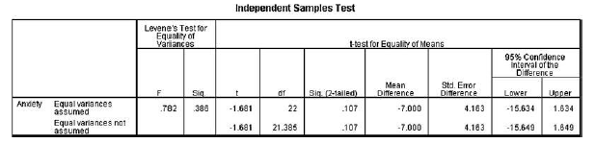
If the Levene’s test is NOT significant (the p value ＞ 0.05), read the first row. If the Levene’s test is significant (the p value ＜ 0.05), read the second row.
If the t-test is significant (the p value ＜ 0.05), it shows that the difference between the means of the two groups in the study is significant. Otherwise, there is no significant difference.

Slide 38
Now
Get it started

Slide 39
04
PART FOUR
The Chi-Square Test

Slide 40
The Chi-Square Test
PART 4
A Chi-square test is used when a comparison is made between the observed frequencies of cases with those expected in a variable which has more than two categories.

Slide 41
The Chi-Square Test
PART 4
子女学习意见调查问卷
您是孩子的：□父亲 □母亲
您的年龄： □35岁以下 □46-44岁 □45岁以上
对于子女的学习，您最重视的是哪一项？
□考试成绩 □生活习惯 □同学关系 □品德行为
4. 您对于目前子女就读学校的整体满意度如何？
□非常满意 □满意 □不满意 □非常不满意
5.您对于目前子女就读班级的整体满意度如何？
□非常满意 □满意 □不满意 □非常不满意
6 …

Slide 42
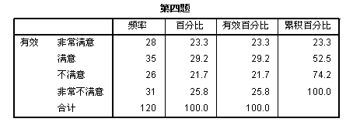
The Chi-Square Test

Slide 43
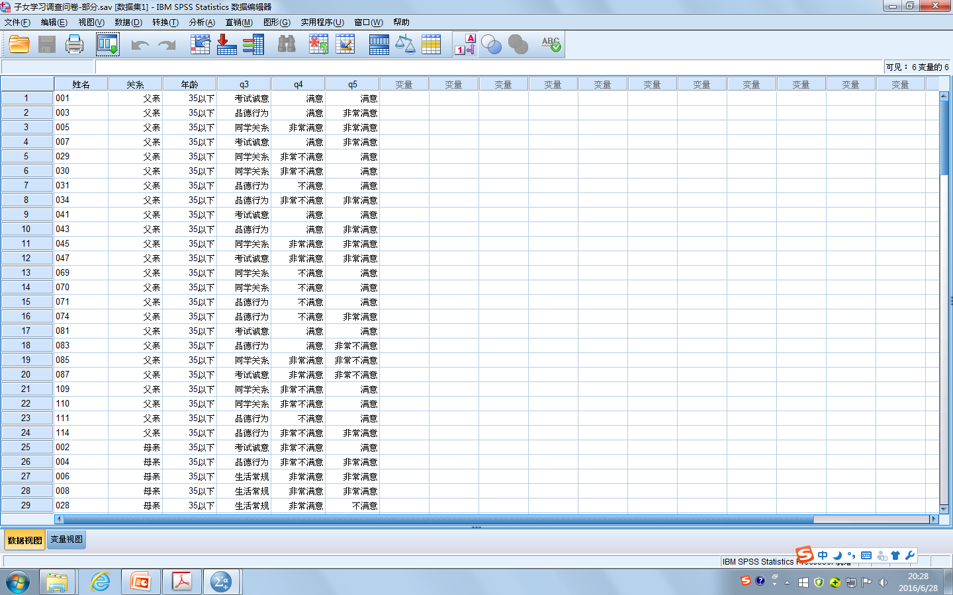

Slide 44
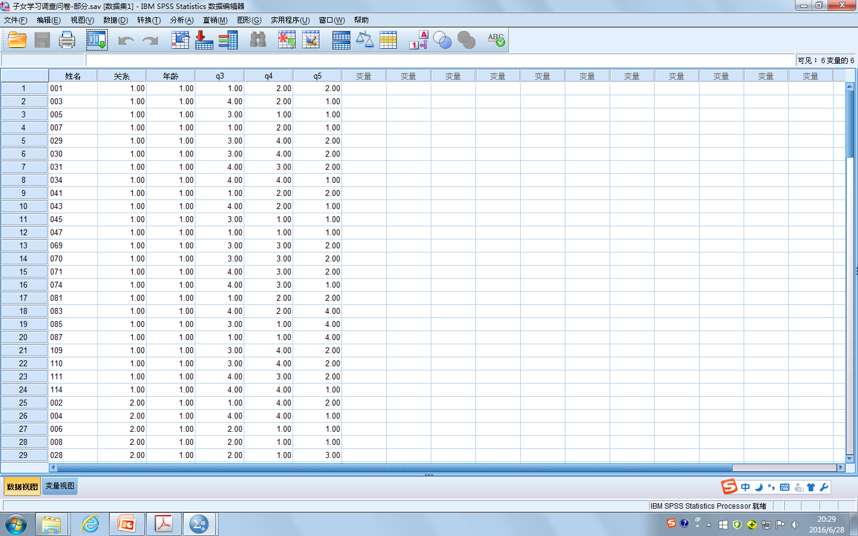

Slide 45
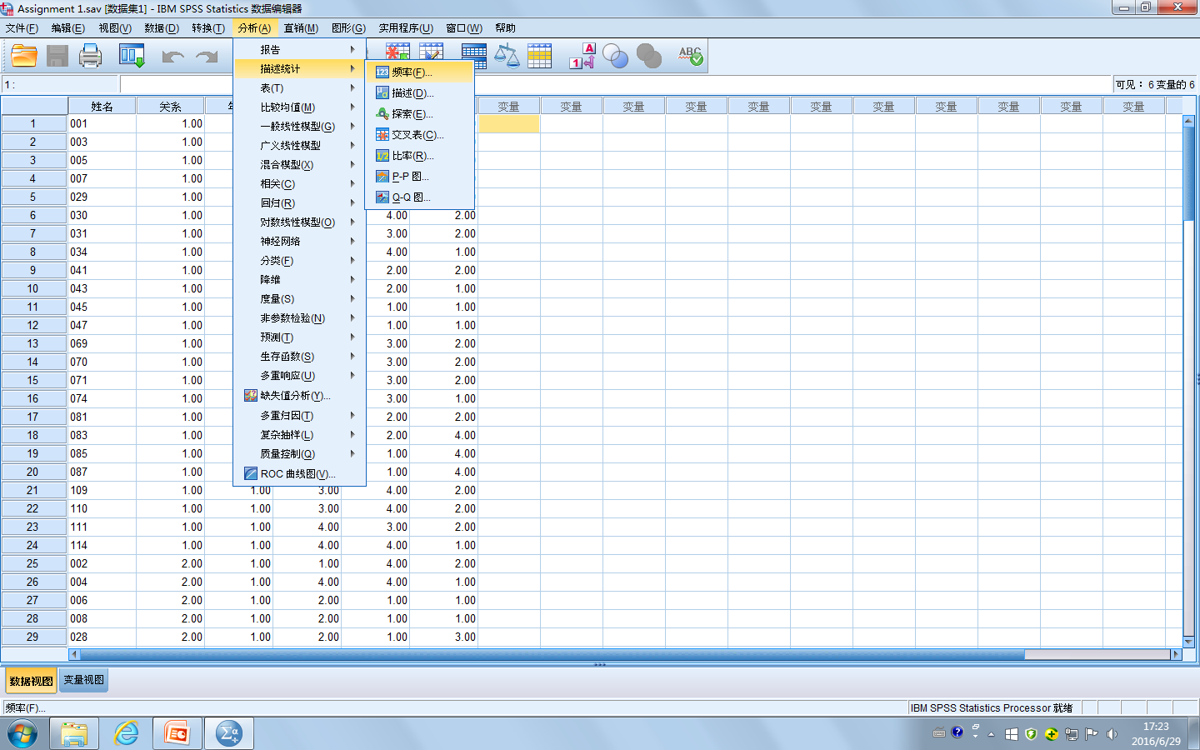

Slide 46
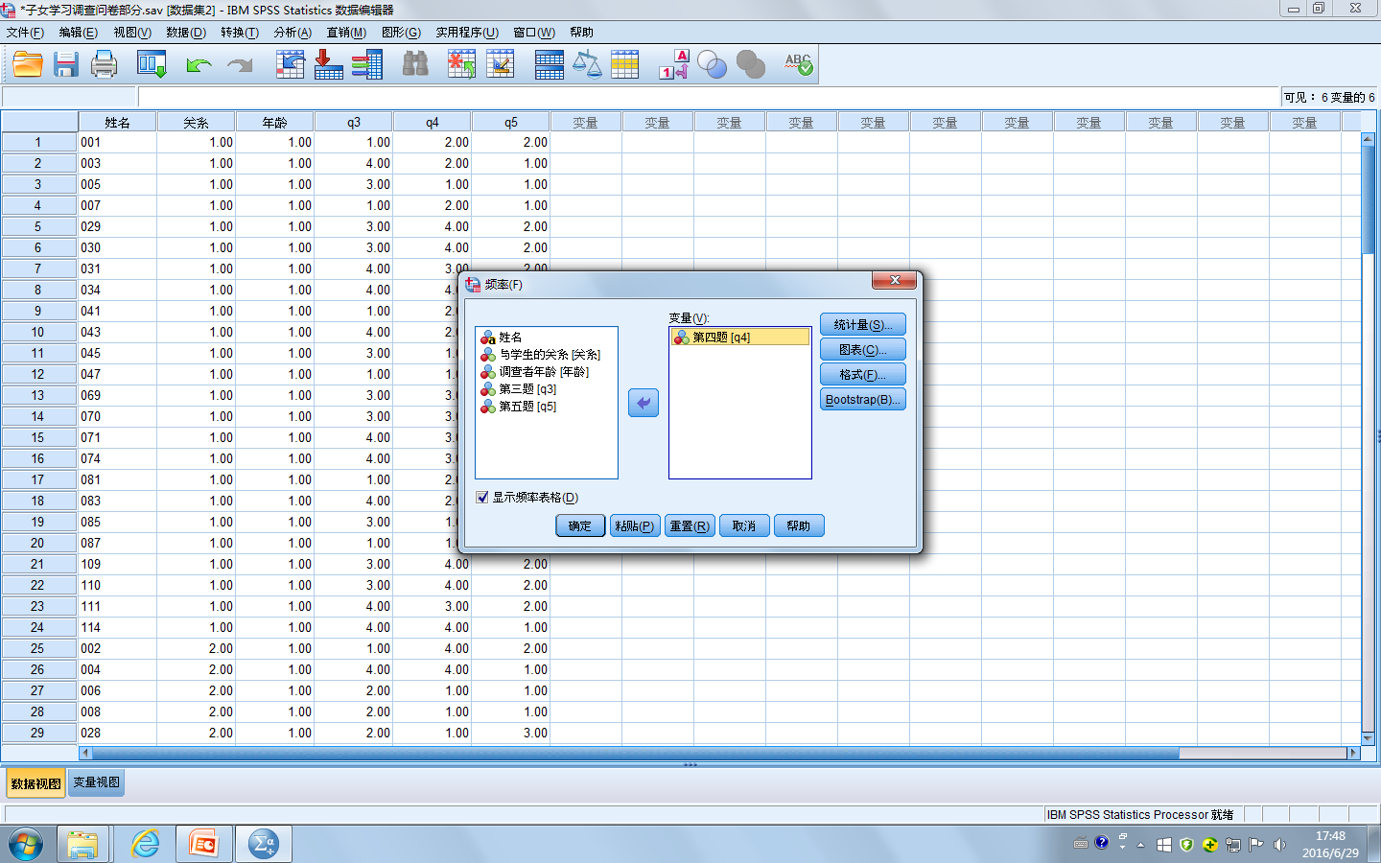

Slide 47
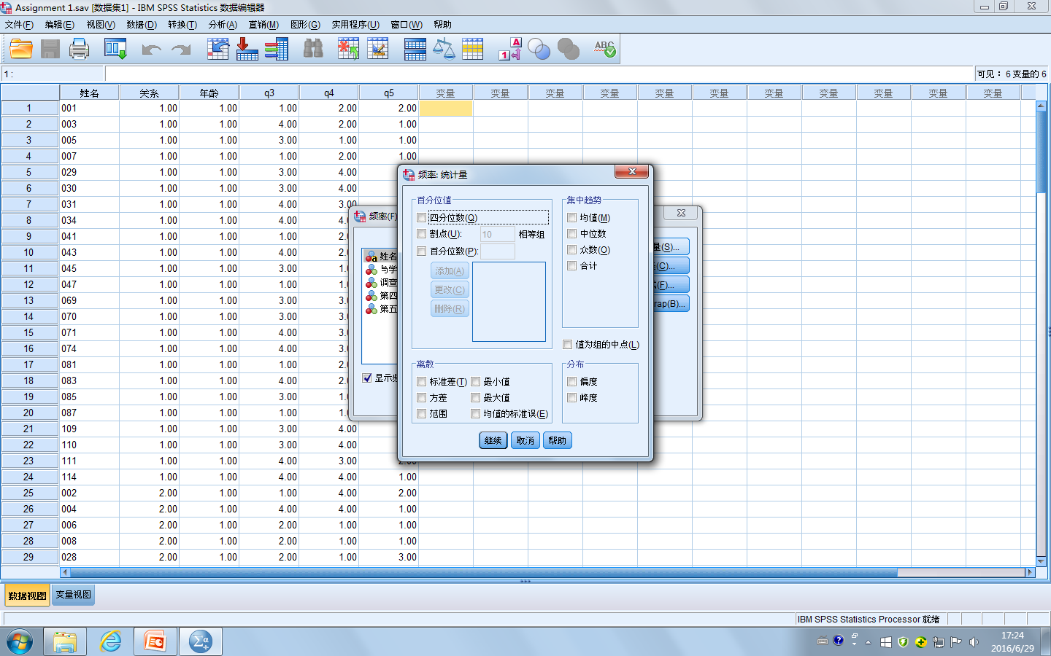

Slide 49
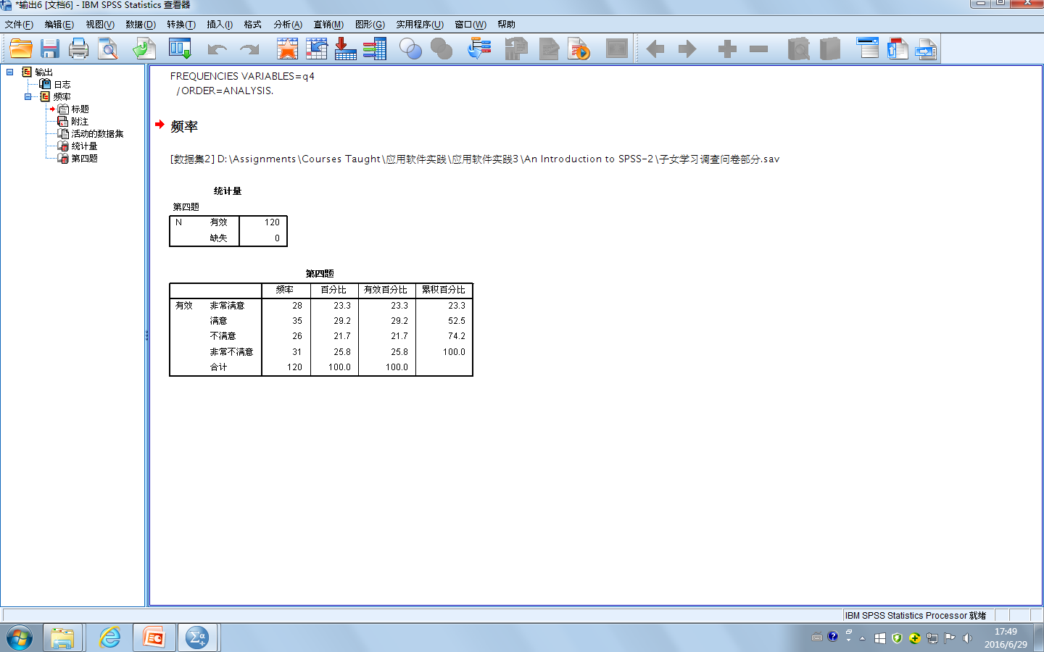

Slide 50


Slide 51
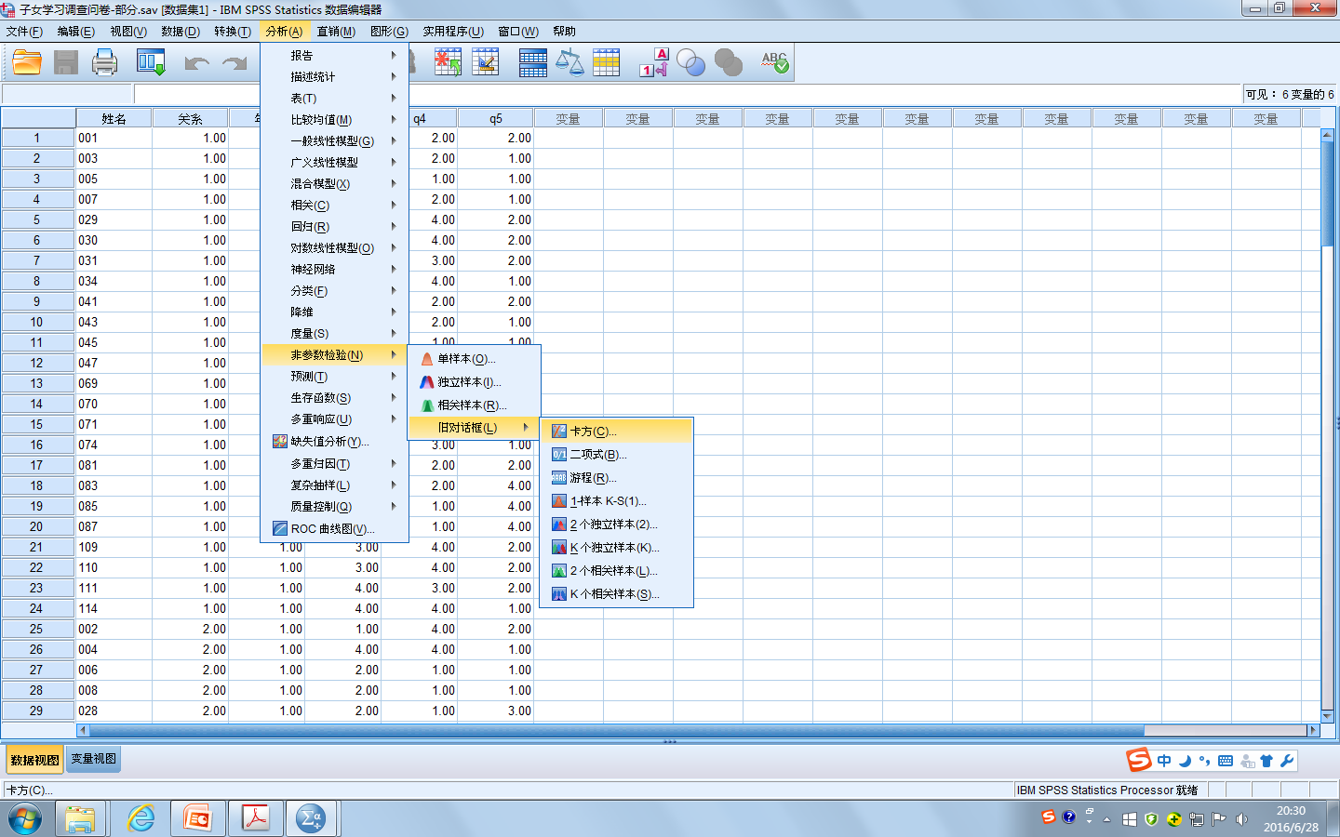

Slide 52
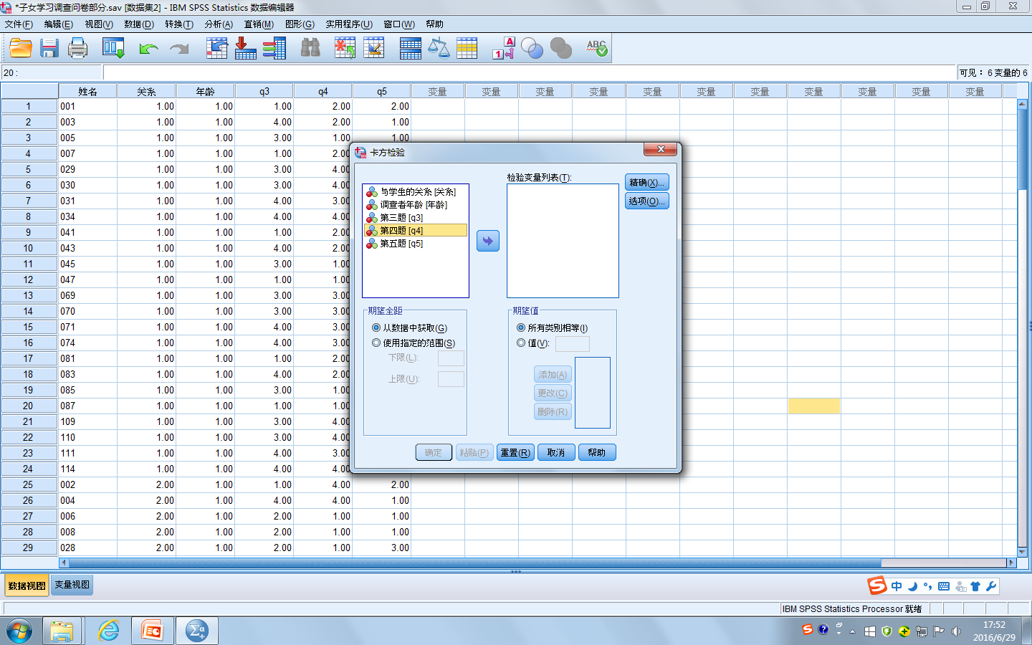

Slide 53
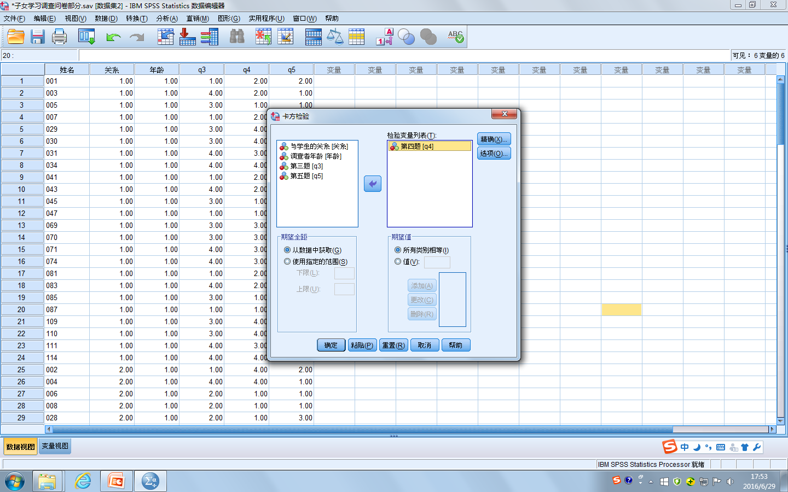

Slide 54
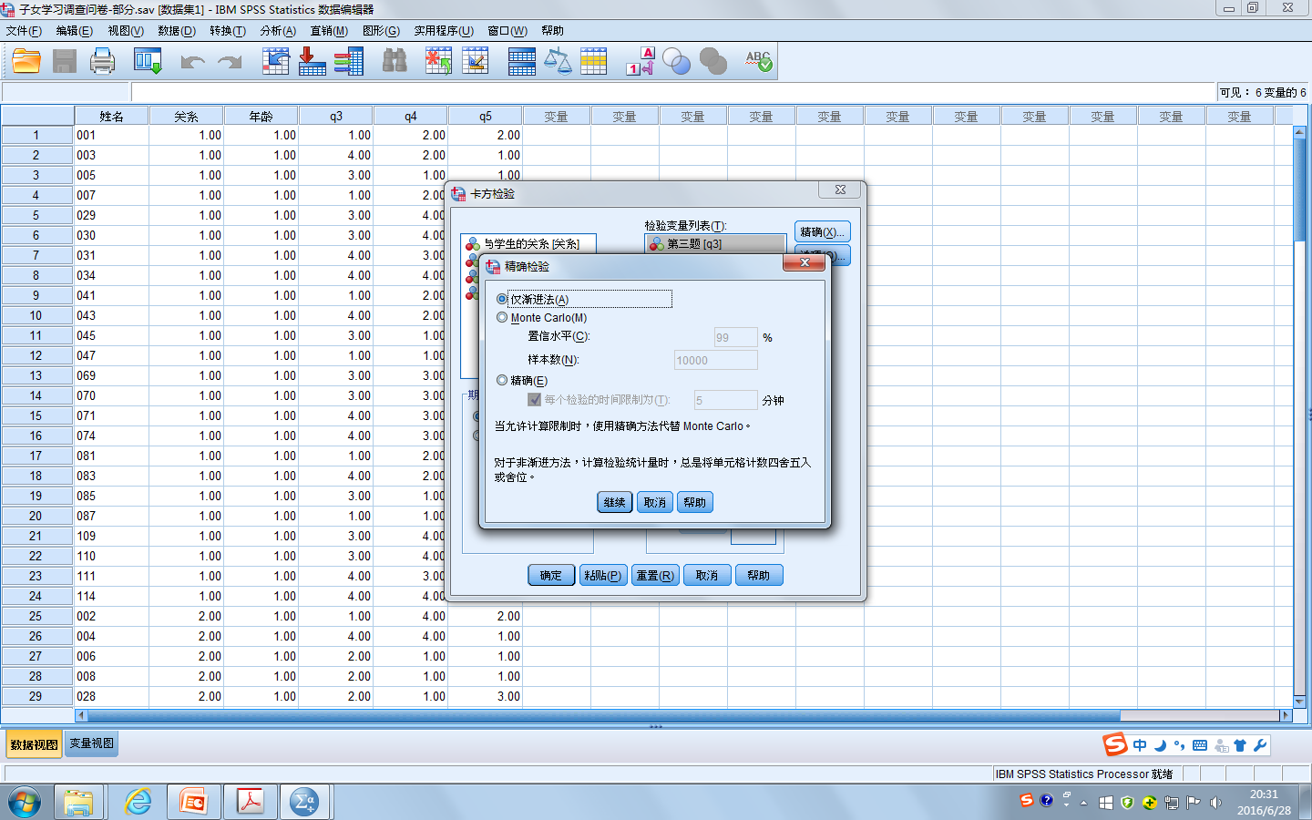

Slide 56
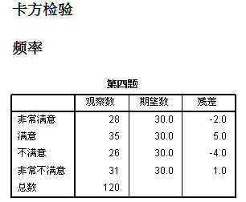
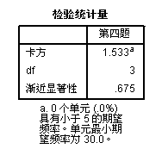
As we can see, the observed frequencies are significantly different (p <
0.0005) from the expected ones of there being an equal number of cases in
each of the four categories. In other words, since the probability of obtaining
this result by chance is very low (at least 5 out of 10,000 times), we would
conclude that the number of workers in each ethnic group is not equal.
The observed frequencies were NOT significantly different (p ＞ 0.05) from the expected ones of there being an equal number of cases in each of the four categories. In other words, we would conclude that the number of cases in each category was quite equal and there was no significant difference among categories.

Slide 57
Assignments
Choose the appropriate SPSS test and analyze the data in the file entitled “Assignment 2-1_2020” to find out whether there was a significant difference between Class A and Class B in terms of the writing score in the final exam, and support the finding with the test results.
Choose the appropriate SPSS test and analyze the data in the file entitled “Assignment 2-2_2020” to find out whether there was a relationship between how well the students learned in the skill courses and how well they learned in the content courses as well as how strong the relationship was, and support the findings with the rest results.
Choose the appropriate SPSS test and analyze the data in the file entitled “Assignment 2-3_2020” to answer the following questions and support the answers with the SPSS test results: Is the test internally reliable? Is it necessary to delete any test items to improve the internal reliability?
Choose the appropriate SPSS test and analyze the data in the file entitled “Assignment 2-4_2020” to find out whether there was a significant difference among the answers to the question about the students’ satisfaction with the course, Academic English, and support the finding with the test results.

Slide 58
THANKS

